Slide 1
Installing windows client machine and attaching it to the domain

Slide 2
What is included
Installing Windows machine
Attaching it to the domain
Loging in with a user on the domain

Slide 3
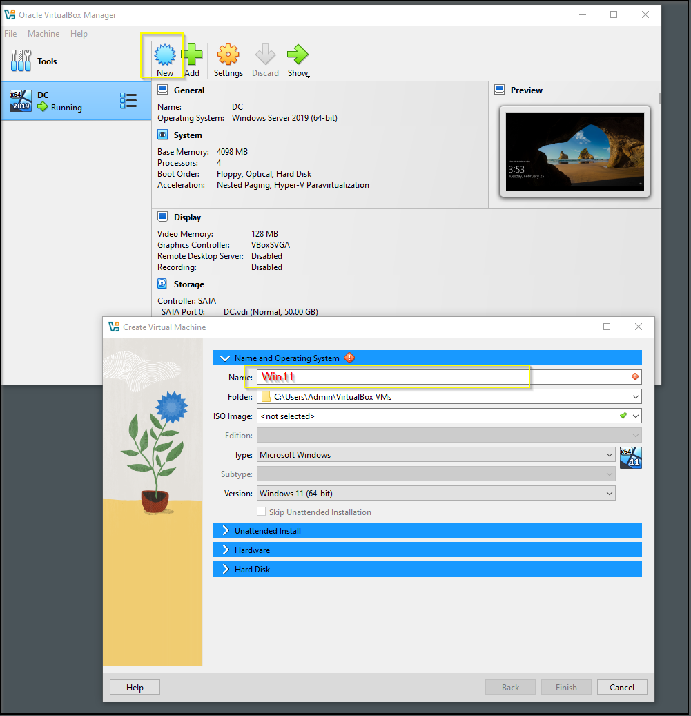
Creating new VM with Windows 11, which we will use to connect to the domain

Slide 4
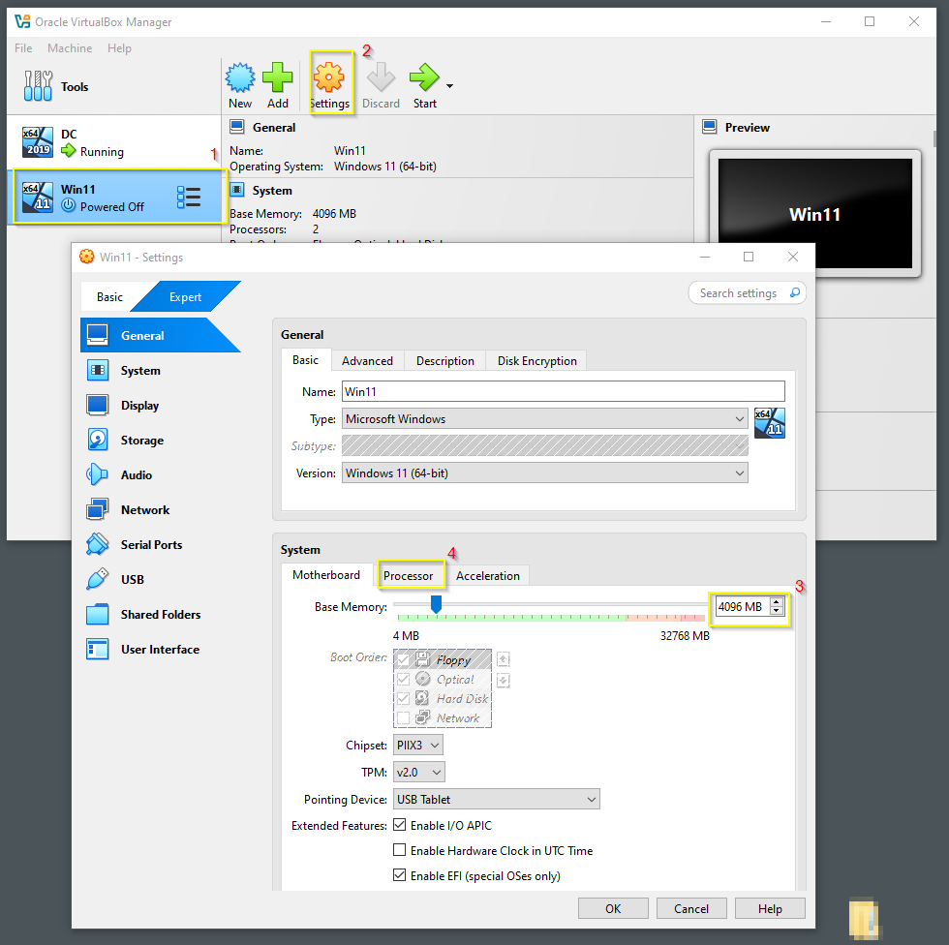
From Settings on the General tab on “Motherboard” assign at least 4 GB of memory, then choose “Processor” tab

Slide 5
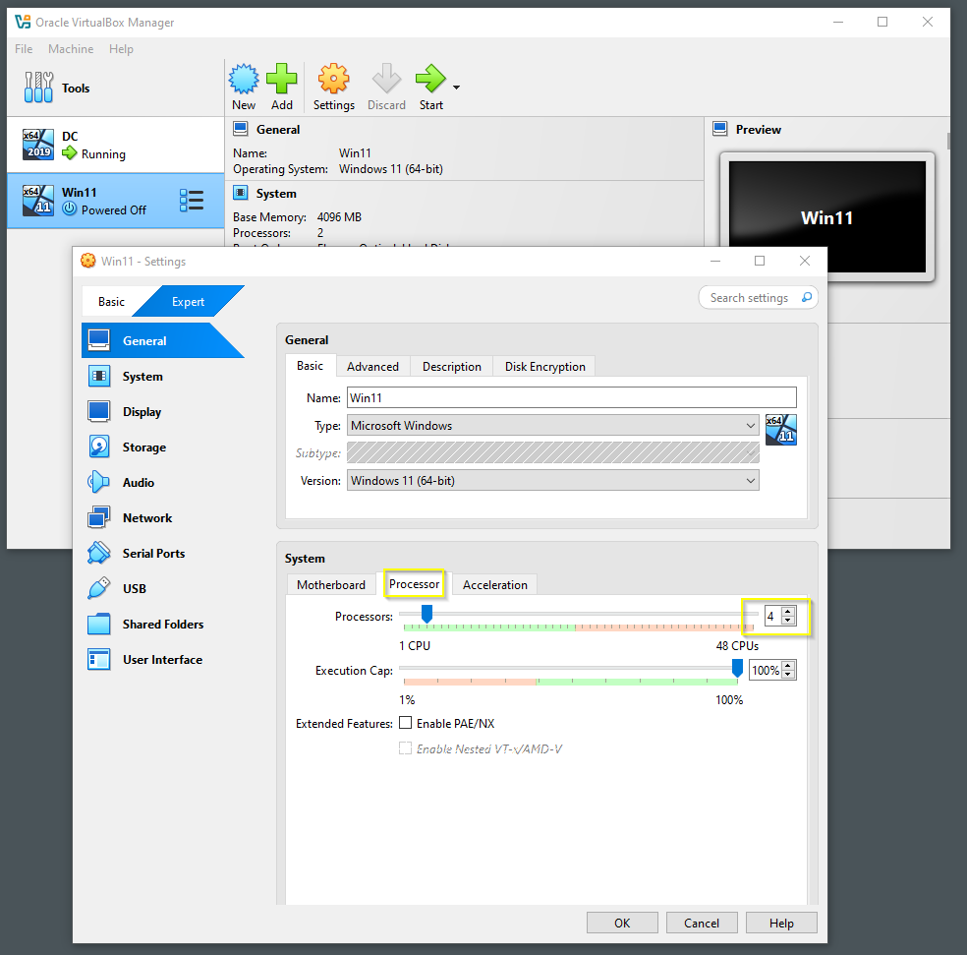
and give it at least 4 cores

Slide 6
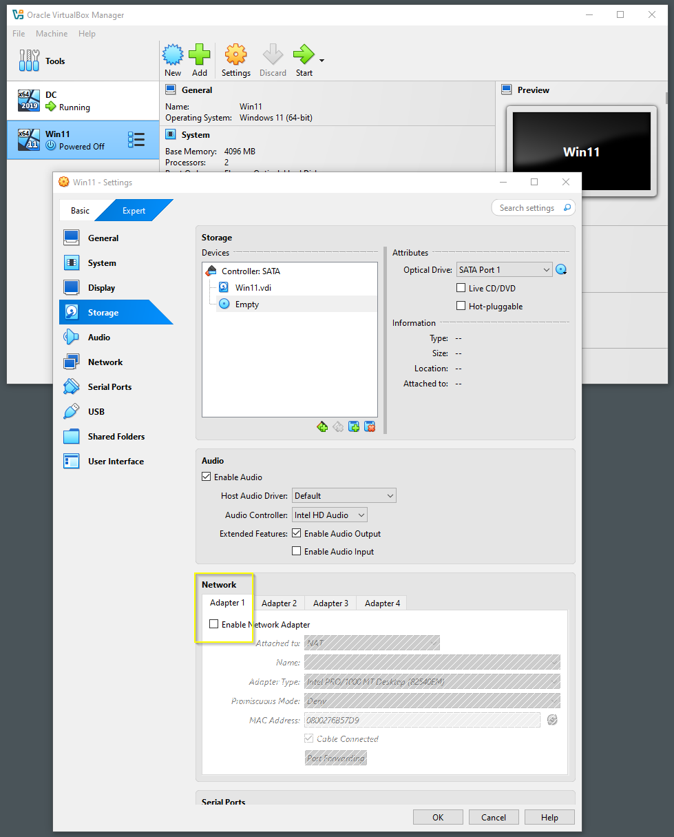
In the Network section on Adapter1, tick Enable

Slide 7
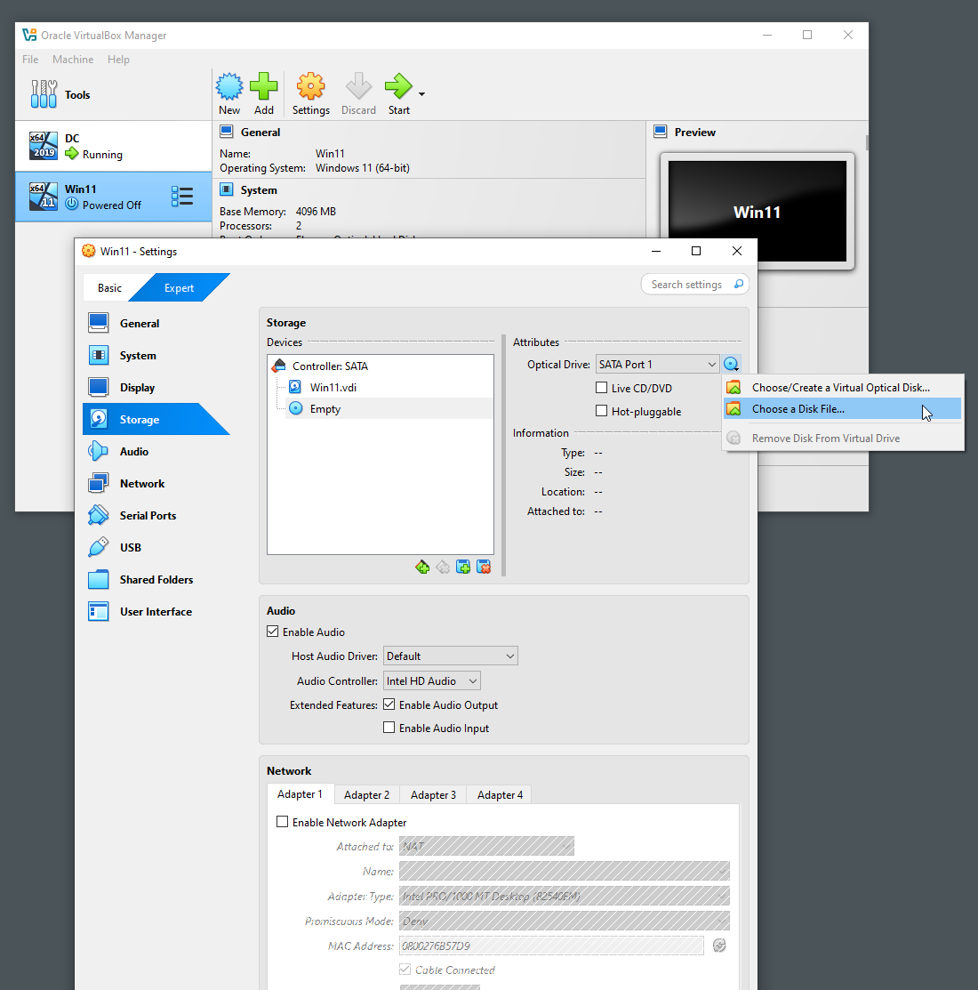
In Storage you have to point to the windows ISO image, so the VM can boot from it when starts.

Slide 8
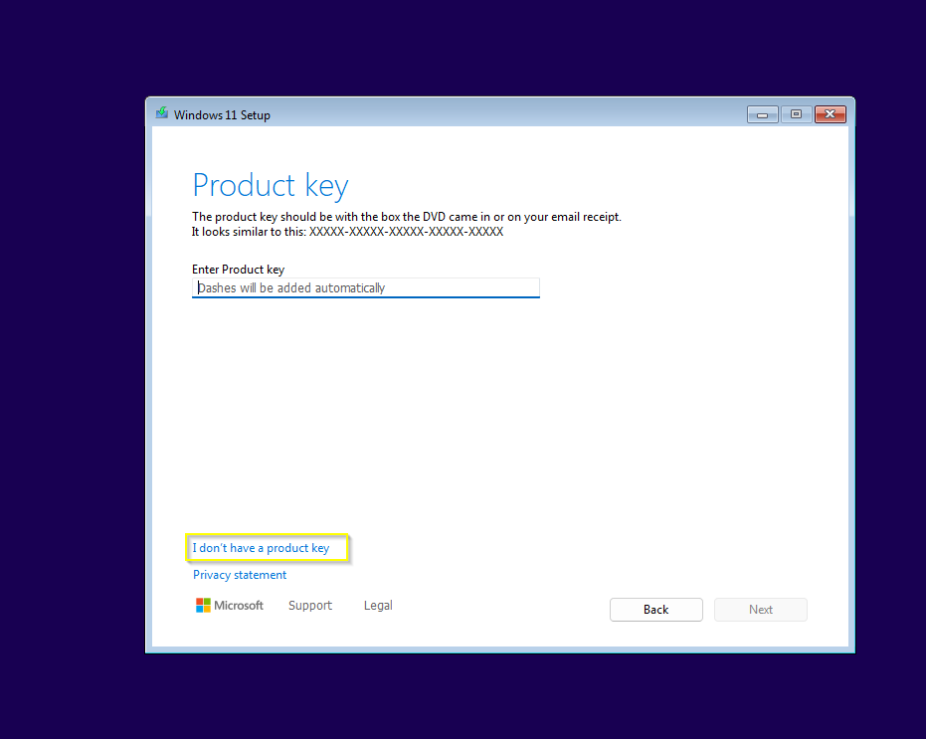
You don’t need license key in order to install this instance of Windows

Slide 9
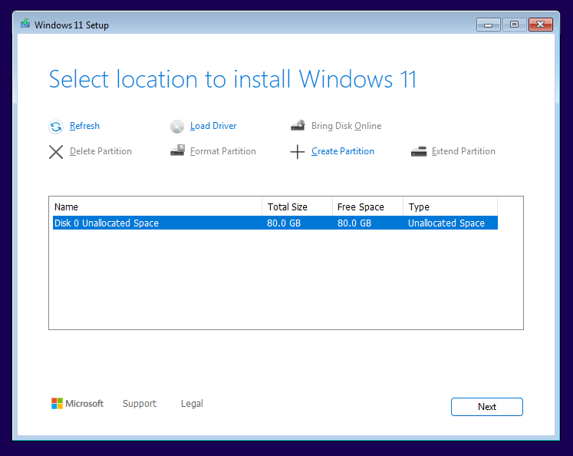
You don’t have to partition the space. Windows will do it for you. Just click on Next on this window.

Slide 10
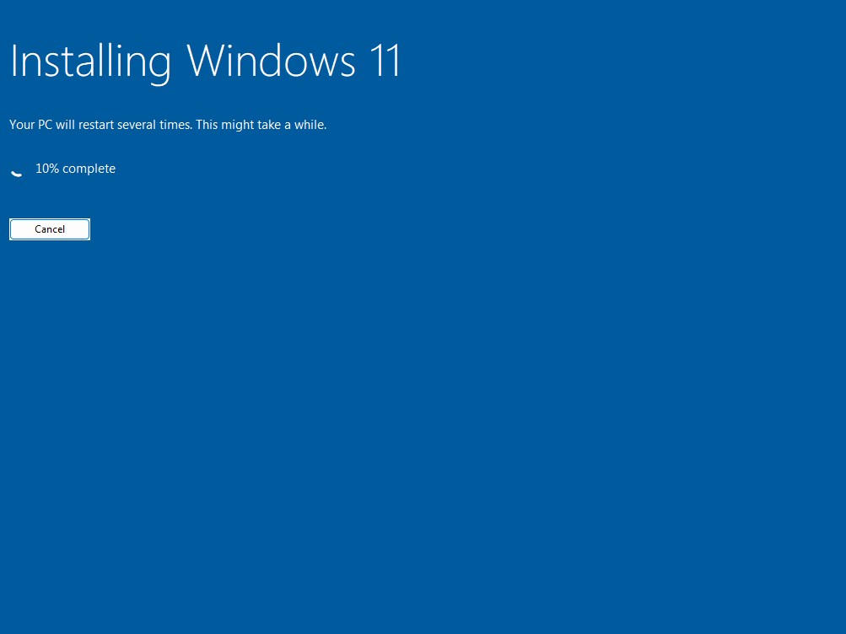
This version of Win 11 doesn’t require a lot of interaction during install.

Slide 11
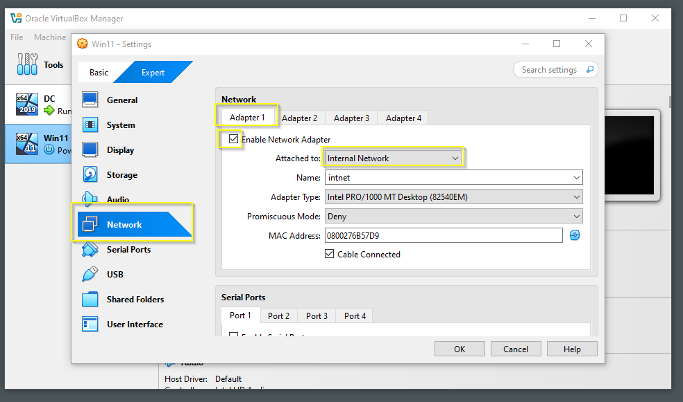

Slide 12
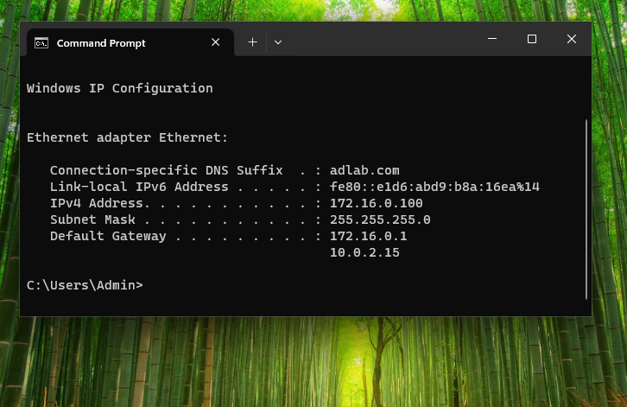
Result from ipconfig command in CMD

Slide 13
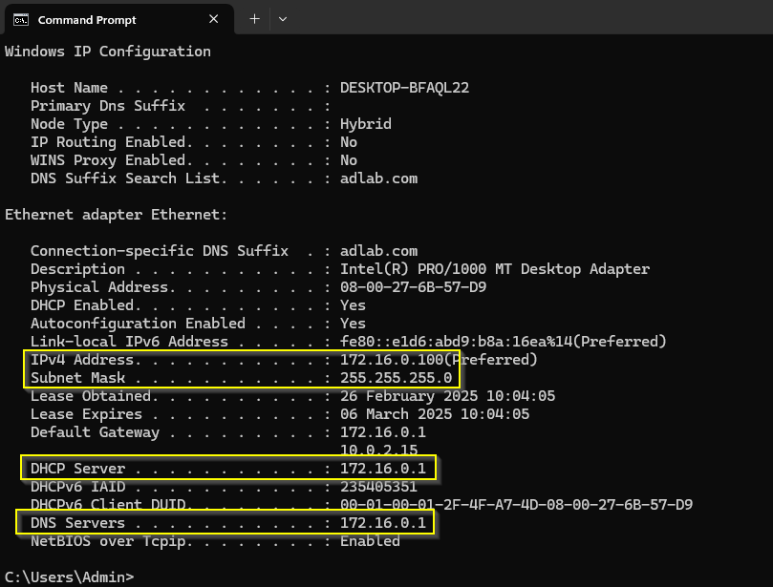
ipconfig /all is showing more info. Your DNS is your DC, and DHCP is working assigning ip addresses

Slide 14
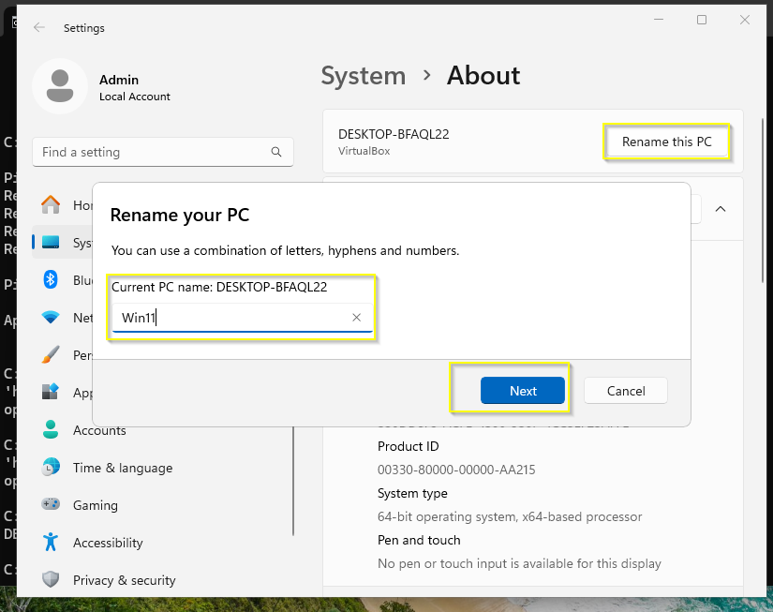
Its time to rename the Windows instance, since this name will show up on the DC list with computers

Slide 15
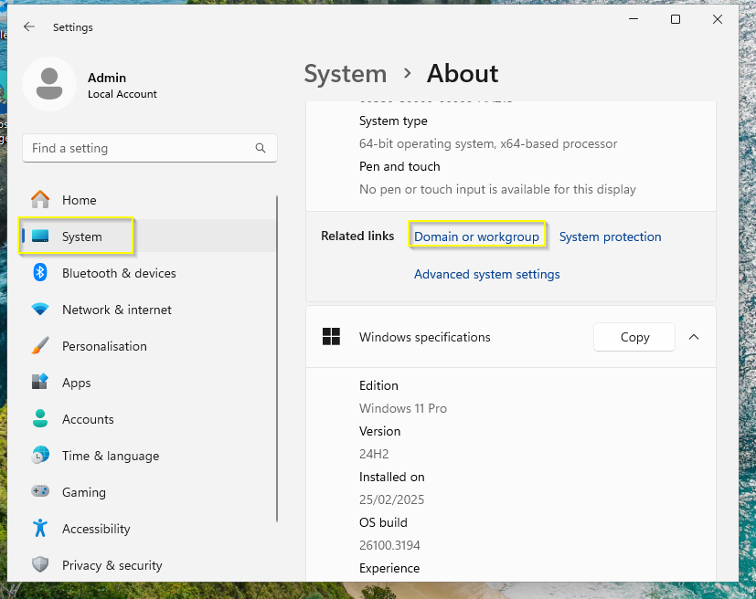
Here you can attach the computer to the domain

Slide 16
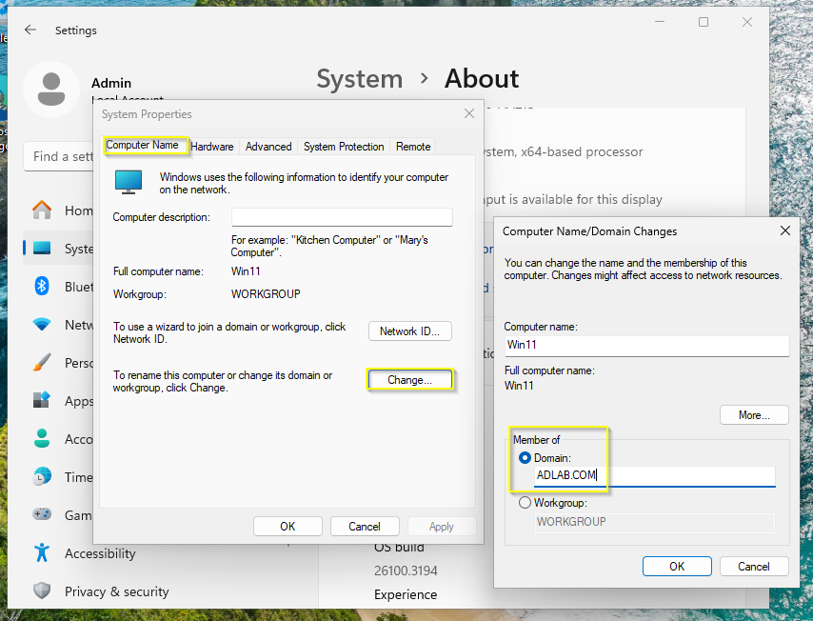
Make sure you input domain name with extension

Slide 17
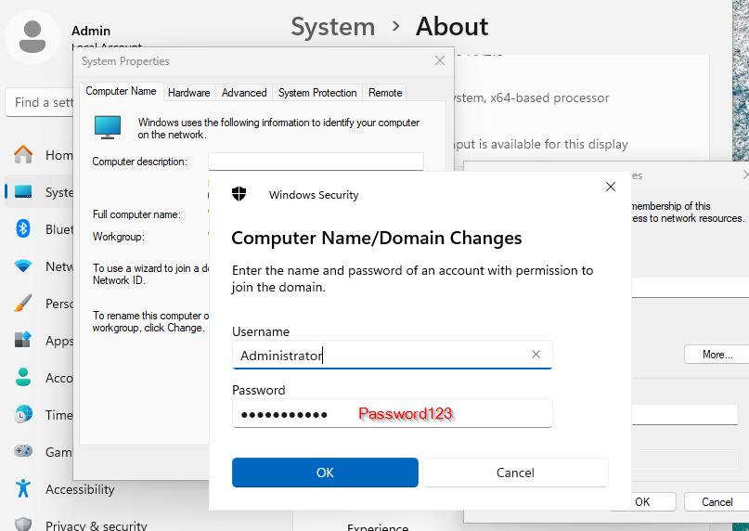
You will need the Admin account and password for the domain

Slide 18
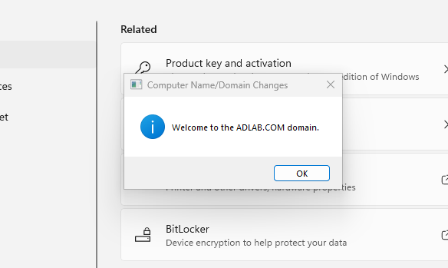
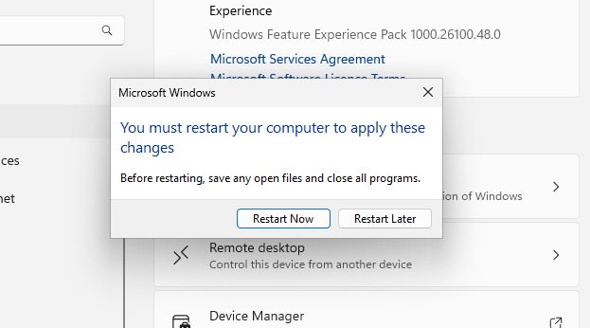
If everything goes ok you will see a welcome message
You must restart the VM

Slide 19
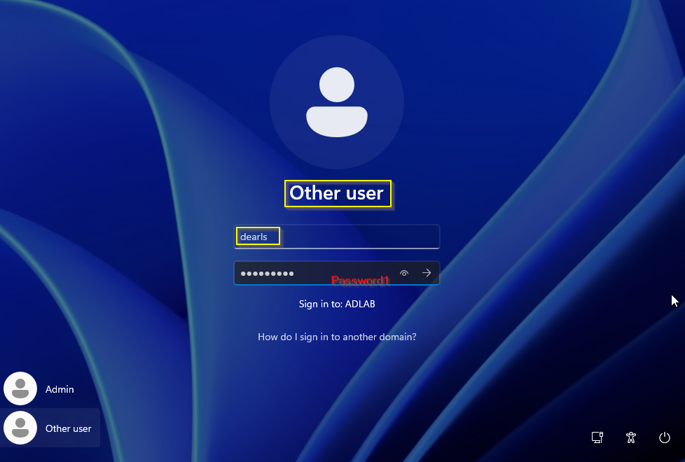
You can log in with any of the users we have created

Slide 20
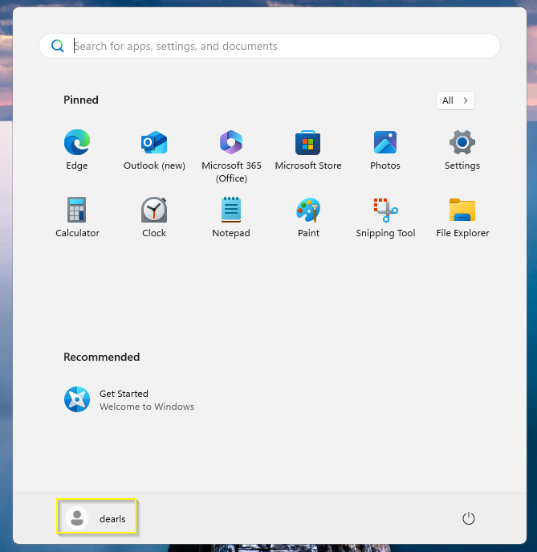
This is the place where you can verify the logged user in Win 11

Slide 21
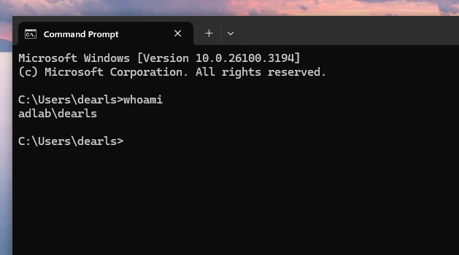
If you use whoami in CMD you could also confirm you are indeed logged in as a user under the domain

Slide 22
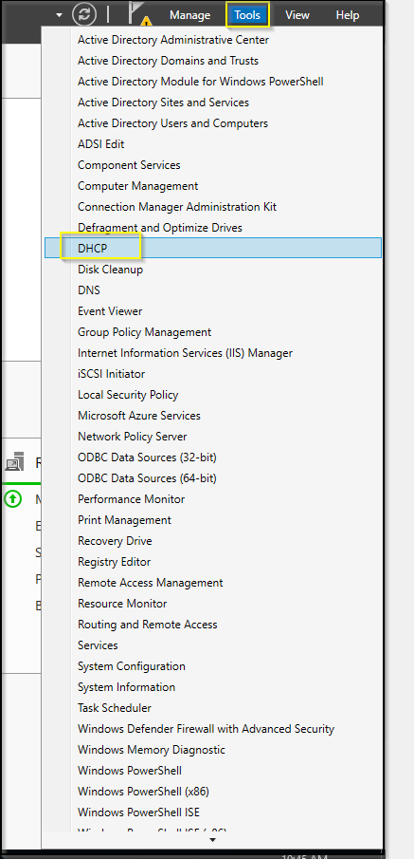
In order to check if connection happened on the Domain controller (DC) side you can check in DHCP under Tools menu

Slide 23
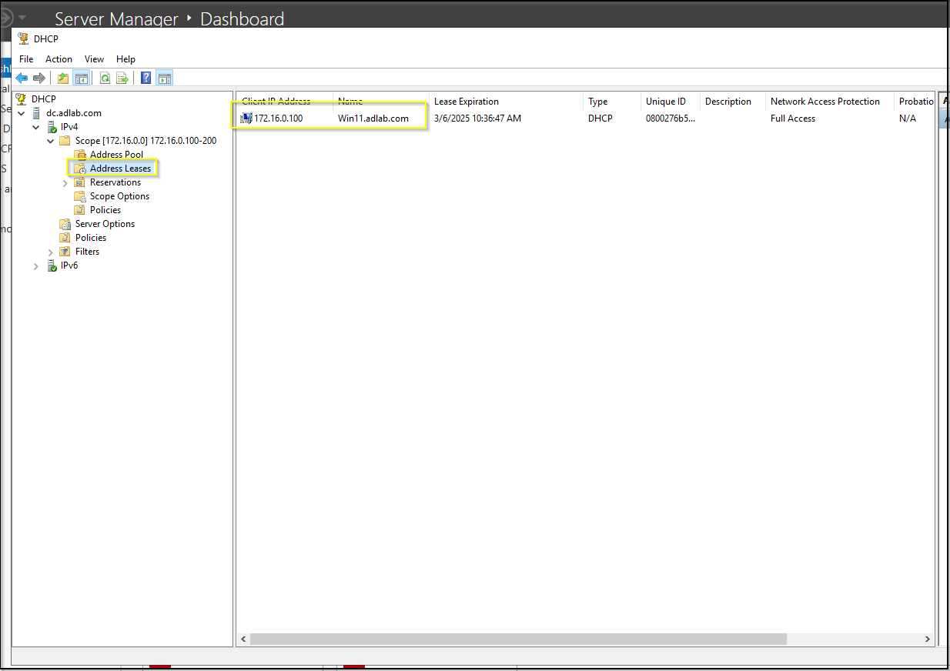
Under Address Leases you can see the IP address assigned to the VM

Slide 24
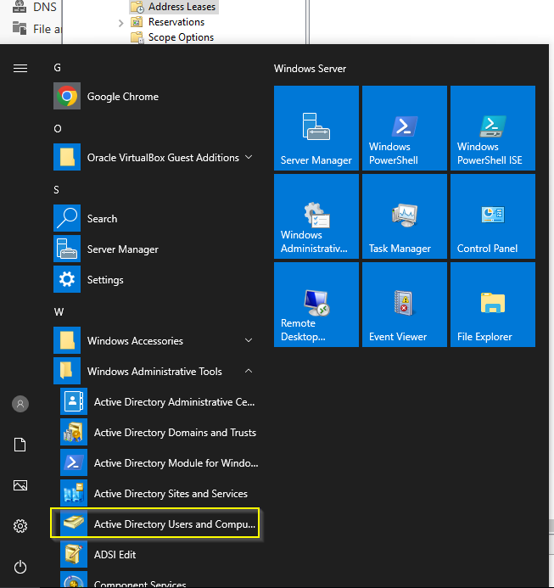
In users and computers in Active directory you can also see some of the info

Slide 25
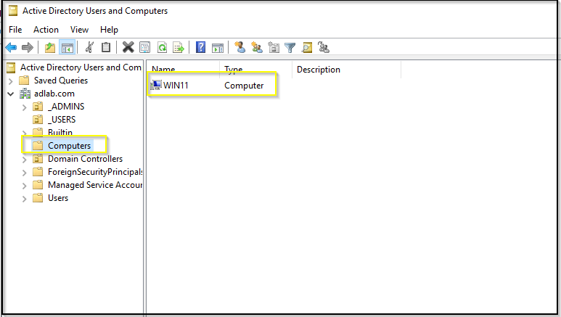
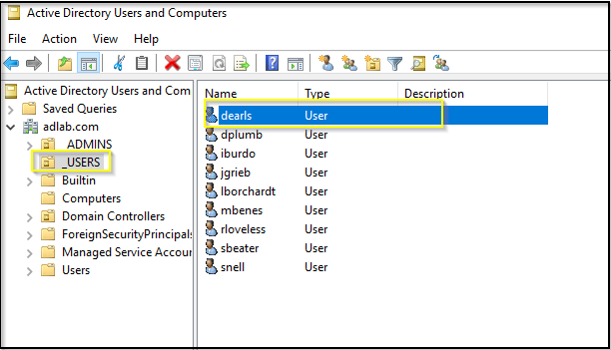
Under Computers you can see the VM with the name we have chosen
And under Users you could see the user

